Slide 1
Review for Skills Test
HTML semantic elements and what they mean
CSS selector behavior, and a few obvious properties
JS basics
Format:
10 Multiple choice
30 minutes

Slide 2
HTML/CSS/JS
HTML is the language of the web. It provides the framework for content to live.
CSS takes this content and gives it form.
JS takes this form and makes it interactive and dynamic.

Slide 3
HTML
There are two main types of HTML tags: inline and block.
Inline tags, such as <span> allow you to define marked up content without having to create a new line break.
Block tags, such as <div> and <p> create a new line every time that the browser encounters this tag.
<div>1</div> 1
<div>2</div> 2
vs…
<span>1</span> 12
<span>2</span>

Slide 4
HTML
Anchor tags are used to define links. They contain an HTML attribute, href, which defines what it links to.
The correct syntax for an anchor tag is:
<a href="https://www.google.com">Hello</a>
Other common HTML attributes you have used…
class="block"
onclick="dosomething()"
id="someId"
style="display: none;"

Slide 5
HTML
HTML is used to provide structure to a document. If you wanted a bulleted list, you should use the <ul> (unordered list) tag. If you wanted a numbered list, you should use the <ol> (ordered list) tag.
A list naturally contains list items, so HTML provides a <li> tag to do so.
The correct syntax for a list is
<ul>
<li>hi</li>
<li>bye</li>
</ul>

Slide 6
CSS
CSS (Cascading Style Sheets) have a different syntax.
.class {
color: green;
}
.class is the CSS selector
{} tell the browser that inside are properties to apply to anything that matches that CSS selector
color is the CSS property
green is the CSS property value

Slide 7
CSS
<div class="block">
<div class="block__content">
<p>element</p>
</div>
</div>
Let's say I want to target all <p>s inside block__content inside block and can't add a class?
.block .block__content p {
color: green;
}

Slide 8
CSS
<a href="https://www.google.com">Google</a>
Let's say I want to do a hover effect. We can use a pseudo selector:
a {
color: green;
}
a:hover {
color: blue;
}

Slide 9
CSS
Media queries can be used to display things differently at different screen sizes. They are used primarily for responsive design.
<p>Hi</p>
Let's say we want the font size to be smaller on all screen sizes below 500px.
p {
font-size: 12px;
}
@media screen and (max-width: 500px) {
p {
font-size: 10px;
}
}

Slide 10
CSS
CSS Variables
:root {
--color: green;
}
.element {
color: var(--color, white);
}
--color is defined at the top as green
.element accesses the color variable and if it doesn't exist, falls back to white.
Final color?
green

Slide 11
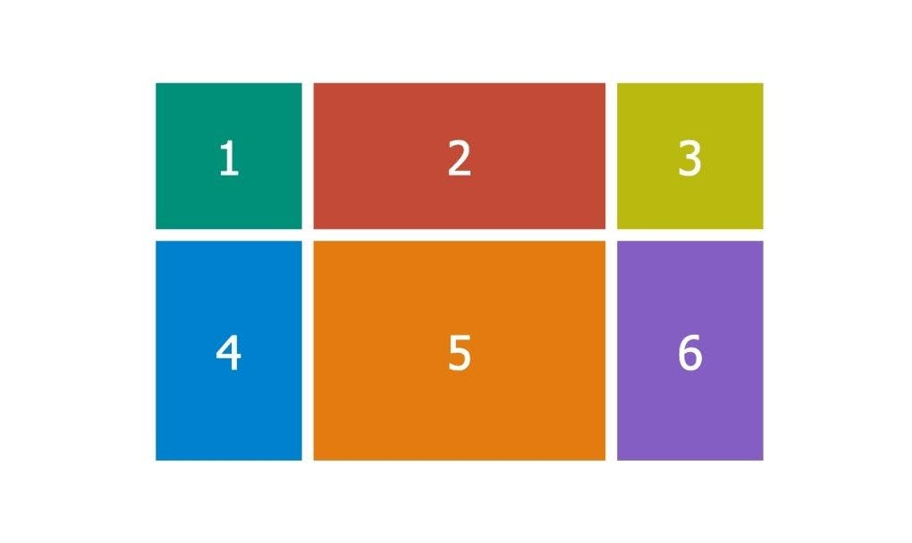
CSS
Flexbox and Grid are two very common tools for layout.
We should use display: flex; when we want to display content flexibly without an even layout.
We should use display: grid; when we want a grid-like layout regardless of content.

Slide 12
CSS
Positioning is a great way to change overall behavior.
position: fixed;
// Displays an element fixed in the viewport
position: relative;
position: absolute;
// Are used together to display something absolutely relative to something else
<div style="position: relative;">
<div style="position: absolute;"></div>
</div>
We often use top, left, bottom, right CSS properties to position absolutely within something.

Slide 13
CSS
display: none;
visibility: hidden;
opacity: 0;
all visually do the same thing. but they mean different things.
display: none;
removes the element completely. there is no space where it would have been. you can't interact with it.
visibility: hidden;
keeps the element there, but makes it invisible. you can't interact with it.
opacity: 0;
keeps the element there, but makes it invisible. you can still interact with it.

Slide 14
Naming Conventions
HMTL/CSS use kebab-case:
<div class="test" data-attribute="1"></div>
.test {
background-color: green;
}
JS uses camelCase:
testEl.styles.backgroundColor = 'green';

Slide 15
JS
<p style="display: none;">Hi</p>
let para = document.querySelector('p');
querySelector gets the first element that matches the provided CSS selector
querySelectorAll gets all the elements that match the provided CSS selector and returns them as an array

Slide 16
JS
JavaScript provides interaction and dynamic behavior.
<button onclick="doSomething()">Click me</button>
<div id="content">hello</div>
<script>
const doSomething = () => {
document.querySelector('#content').innerText = 'goodbye';
}
</script>
onclick is an attribute that runs the inside JavaScript on click
doSomething is the name of a variable
() => {} is a function signature. It tells the browser that this is a function
() tells the browser that there are no parameters that are being provided
What happens after this executes?
The inner text of the content container is now goodbye

Slide 17
JS
<p style="display: none;">Hi</p>
let para = document.querySelector('p');
if (para.style.display == 'none') {
para.style.display = 'block';
} else {
para.style.display = 'none';
}
We now use an if statement. It runs the first block inside the {} if the statement inside the parentheses () is true.
para.style.display gets the inline style value of display, which is a string none
'none' == 'none'
Therefore the first line runs.
What happens at the end of execution?
Hi is now visible

Slide 18
JS
let count = 0;
for (let i = 0; i < 10; i++) {
count = count + 1;
}
We declare a variable called count and set it to 0
We use something called a for loop. We read it…
let i = 0 (initial condition at the beginning of this)
i < 10 (run while this is true)
i++ (short hand for i = i + 1 which runs at the end of each loop)
count = count + 1 (each time this runs increases by 1)
What is count at the end of this?
count = 10

Slide 19
Forms
Briefly:
<form>
<input type="text" placeholder="Do something">
<button type="submit">
</form>
Form is an HTML element that lets you provide information
They are the base of user provided interactivity.
There are different types of input fields you can have in a form.
https://developer.mozilla.org/en-US/docs/Web/HTML/Element/input
At the end, we always use a button to submit things.

